Slide 1
Bootstrap

Slide 2
Bootstrap
Bootstrap is a front-end framework that helps you build websites faster and more consistently.
In plain terms: it’s a big toolkit of ready-made CSS styles and JavaScript components so you don’t have to design everything from scratch.

Slide 3
Bootstrap
What Bootstrap gives you
Responsive layout system
A grid that automatically adapts to phones, tablets, and desktops.
Pre-styled components
Buttons, forms, navbars, modals, alerts, cards, etc.—all styled and ready to use.
Consistent design
Everything follows the same spacing, typography, and color rules.
Utility classes
Quick helpers like margins, padding, text alignment, display options (mt-3, text-center, d-flex, etc.).

Slide 4
Bootstrap
What it’s used for
Rapid prototyping
Admin dashboards
Simple to medium-complexity websites
Projects where consistency matters more than ultra-custom design
https://getbootstrap.com/

Slide 5
Bootstrap
Bootstrap vs Custom CSS
Bootstrap | Custom CSS
Fast setup | Full control
Prebuilt components | Manual styling
Responsive grid | More time

Slide 6
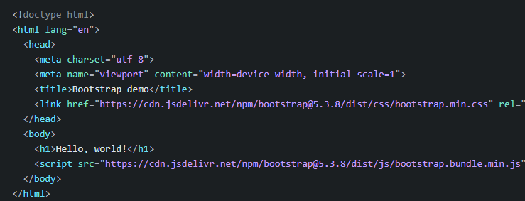
Bootstrap
Include Bootstrap’s CSS and JS.
Place the <link> tag in the <head> for our CSS, and the <script> tag for our JavaScript bundle (including Popper for positioning dropdowns, popovers, and tooltips) before the closing </body>. Learn more about our CDN links
Notes:
<!doctype html>
<html lang="en">
<head>
<meta charset="utf-8">
<meta name="viewport" content="width=device-width, initial-scale=1">
<title>Bootstrap demo</title>
<link href="https://cdn.jsdelivr.net/npm/bootstrap@5.3.8/dist/css/bootstrap.min.css" rel="stylesheet" integrity="sha384-sRIl4kxILFvY47J16cr9ZwB07vP4J8+LH7qKQnuqkuIAvNWLzeN8tE5YBujZqJLB" crossorigin="anonymous">
</head>
<body>
<h1>Hello, world!</h1>
<script src="https://cdn.jsdelivr.net/npm/bootstrap@5.3.8/dist/js/bootstrap.bundle.min.js" integrity="sha384-FKyoEForCGlyvwx9Hj09JcYn3nv7wiPVlz7YYwJrWVcXK/BmnVDxM+D2scQbITxI" crossorigin="anonymous"></script>
</body>
</html>

Slide 7
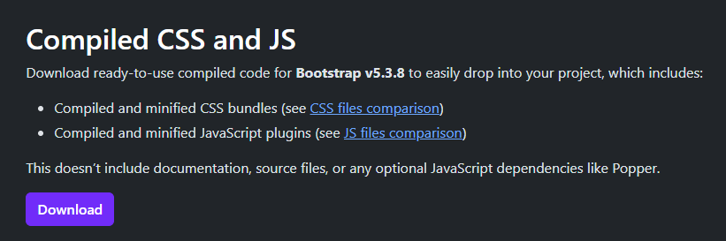
Bootstrap
Or by download all files from here
https://getbootstrap.com/docs/5.3/getting-started/download/
Notes:
<!doctype html>
<html lang="en">
<head>
<meta charset="utf-8">
<meta name="viewport" content="width=device-width, initial-scale=1">
<title>Bootstrap demo</title>
<link href="https://cdn.jsdelivr.net/npm/bootstrap@5.3.8/dist/css/bootstrap.min.css" rel="stylesheet" integrity="sha384-sRIl4kxILFvY47J16cr9ZwB07vP4J8+LH7qKQnuqkuIAvNWLzeN8tE5YBujZqJLB" crossorigin="anonymous">
</head>
<body>
<h1>Hello, world!</h1>
<script src="https://cdn.jsdelivr.net/npm/bootstrap@5.3.8/dist/js/bootstrap.bundle.min.js" integrity="sha384-FKyoEForCGlyvwx9Hj09JcYn3nv7wiPVlz7YYwJrWVcXK/BmnVDxM+D2scQbITxI" crossorigin="anonymous"></script>
</body>
</html>

Slide 8
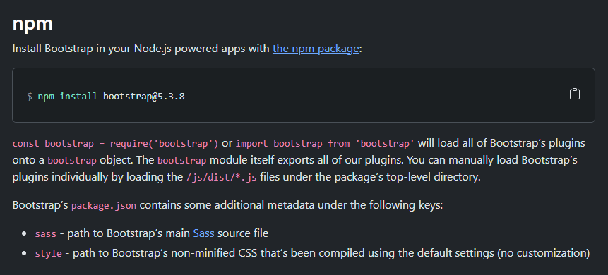
Bootstrap
To install in node.js
npm install bootstrap@5.3.8
Notes:
<!doctype html>
<html lang="en">
<head>
<meta charset="utf-8">
<meta name="viewport" content="width=device-width, initial-scale=1">
<title>Bootstrap demo</title>
<link href="https://cdn.jsdelivr.net/npm/bootstrap@5.3.8/dist/css/bootstrap.min.css" rel="stylesheet" integrity="sha384-sRIl4kxILFvY47J16cr9ZwB07vP4J8+LH7qKQnuqkuIAvNWLzeN8tE5YBujZqJLB" crossorigin="anonymous">
</head>
<body>
<h1>Hello, world!</h1>
<script src="https://cdn.jsdelivr.net/npm/bootstrap@5.3.8/dist/js/bootstrap.bundle.min.js" integrity="sha384-FKyoEForCGlyvwx9Hj09JcYn3nv7wiPVlz7YYwJrWVcXK/BmnVDxM+D2scQbITxI" crossorigin="anonymous"></script>
</body>
</html>

Slide 9
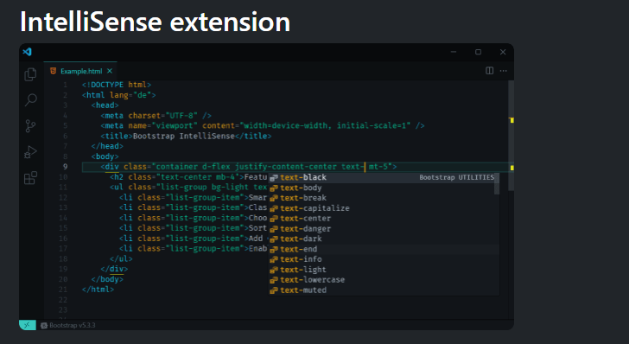
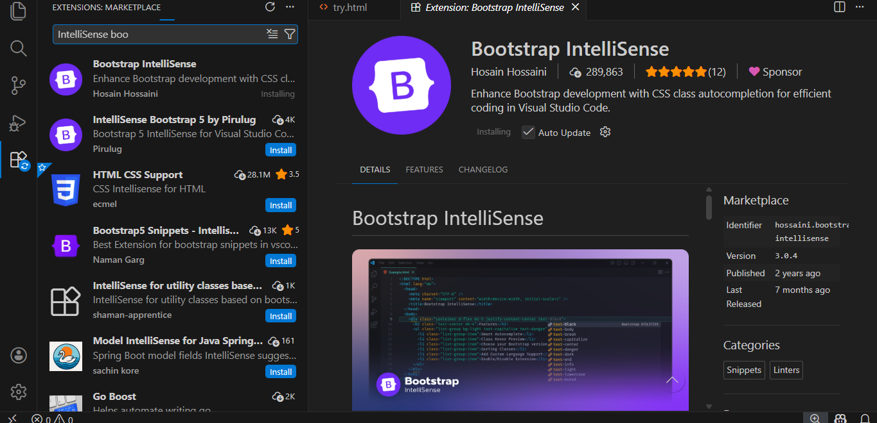
Bootstrap
Add in VS Code extension
(IntelliSense )
Notes:
<!doctype html>
<html lang="en">
<head>
<meta charset="utf-8">
<meta name="viewport" content="width=device-width, initial-scale=1">
<title>Bootstrap demo</title>
<link href="https://cdn.jsdelivr.net/npm/bootstrap@5.3.8/dist/css/bootstrap.min.css" rel="stylesheet" integrity="sha384-sRIl4kxILFvY47J16cr9ZwB07vP4J8+LH7qKQnuqkuIAvNWLzeN8tE5YBujZqJLB" crossorigin="anonymous">
</head>
<body>
<h1>Hello, world!</h1>
<script src="https://cdn.jsdelivr.net/npm/bootstrap@5.3.8/dist/js/bootstrap.bundle.min.js" integrity="sha384-FKyoEForCGlyvwx9Hj09JcYn3nv7wiPVlz7YYwJrWVcXK/BmnVDxM+D2scQbITxI" crossorigin="anonymous"></script>
</body>
</html>

Slide 10
Bootstrap
RTL
Learn how to enable support for right-to-left text in Bootstrap across our layout, components, and utilities.
<link rel="stylesheet" href="https://cdn.jsdelivr.net/npm/bootstrap@5.3.8/dist/css/bootstrap.rtl.min.css" integrity="sha384-CfCrinSRH2IR6a4e6fy2q6ioOX7O6Mtm1L9vRvFZ1trBncWmMePhzvafv7oIcWiW" crossorigin="anonymous">
Notes:
<!doctype html>
<html lang="en">
<head>
<meta charset="utf-8">
<meta name="viewport" content="width=device-width, initial-scale=1">
<title>Bootstrap demo</title>
<link href="https://cdn.jsdelivr.net/npm/bootstrap@5.3.8/dist/css/bootstrap.min.css" rel="stylesheet" integrity="sha384-sRIl4kxILFvY47J16cr9ZwB07vP4J8+LH7qKQnuqkuIAvNWLzeN8tE5YBujZqJLB" crossorigin="anonymous">
</head>
<body>
<h1>Hello, world!</h1>
<script src="https://cdn.jsdelivr.net/npm/bootstrap@5.3.8/dist/js/bootstrap.bundle.min.js" integrity="sha384-FKyoEForCGlyvwx9Hj09JcYn3nv7wiPVlz7YYwJrWVcXK/BmnVDxM+D2scQbITxI" crossorigin="anonymous"></script>
</body>
</html>

Slide 11
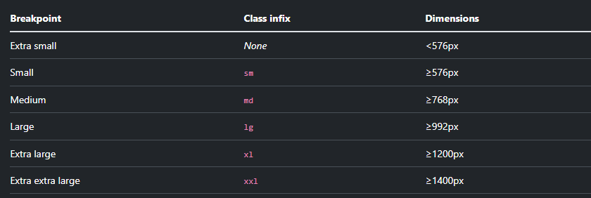
Bootstrap
Available breakpoints
Bootstrap includes six default breakpoints, sometimes referred to as grid tiers, for building responsively. These breakpoints can be customized if you’re using our source Sass files.
Notes:
https://getbootstrap.com/docs/5.3/layout/breakpoints/

Slide 12
Bootstrap
Containers
Containers are a fundamental building block of Bootstrap that contain, pad, and align your content within a given device or viewport.
How they work
Containers are the most basic layout element in Bootstrap and are required when using our default grid system. Containers are used to contain, pad, and (sometimes) center the content within them. While containers can be nested, most layouts do not require a nested container.
Bootstrap comes with three different containers:
.container, which sets a max-width at each responsive breakpoint
.container-{breakpoint}, which is width: 100% until the specified breakpoint
.container-fluid, which is width: 100% at all breakpoints
The table below illustrates how each container’s max-width compares to the original .container and .container-fluid across each breakpoint.
Notes:
https://getbootstrap.com/docs/5.3/layout/containers/

Slide 13
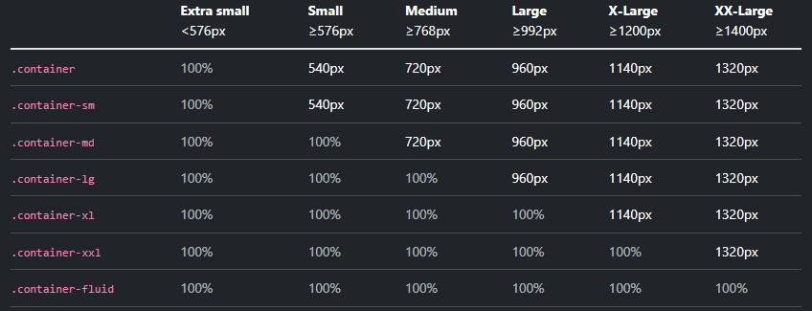
Bootstrap
Containers
Containers are a fundamental building block of Bootstrap that contain, pad, and align your content within a given device or viewport.
Notes:
https://getbootstrap.com/docs/5.3/layout/containers/

Slide 14
Bootstrap
Containers
<div class="container">
<h1>Hello Bootstrap</h1>
<p>This content is centered and has margins on both sides.</p>
</div>
Notes:
https://getbootstrap.com/docs/5.3/layout/containers/

Slide 15

Bootstrap
Containers
<div class="container-fluid">
<h1>Hello Bootstrap</h1>
<p>This content is centered and has margins on both sides.</p>
</div>
Notes:
https://getbootstrap.com/docs/5.3/layout/containers/

Slide 16
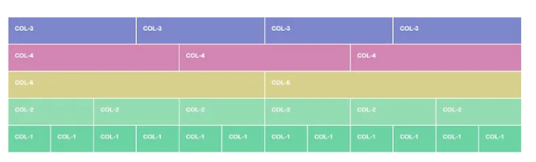
Bootstrap
Grid system
Use our powerful mobile-first flexbox grid to build layouts of all shapes and sizes thanks to a twelve column system, six default responsive tiers, Sass variables and mixins, and dozens of predefined classes.
Notes:
https://medium.com/why-i-chose-to-switch-career-paths-and-pursue/bootstrap-4-grid-system-10565a957020

Slide 17
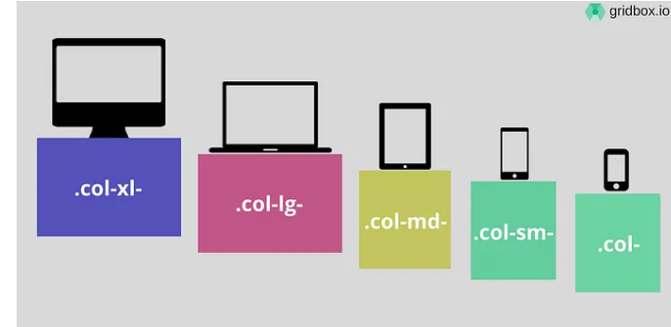
Bootstrap
Responsive Web Design
Responsive web design is the design and development around a user’s behavior and environment based on screen size, platform and orientation. Automatically scaling a site’s content and elements to match the screen size on which it is viewed is increasingly important as more and more people access the web from their cellphone on the go.
Notes:
https://medium.com/why-i-chose-to-switch-career-paths-and-pursue/bootstrap-4-grid-system-10565a957020

Slide 18
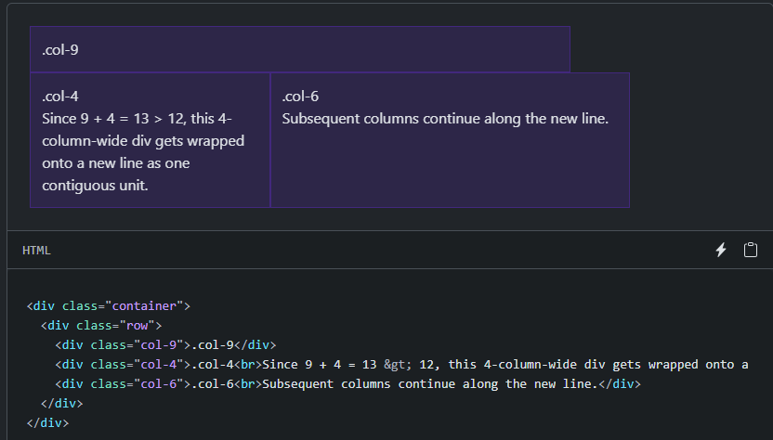
Bootstrap
Responsive Web Design
Responsive web design is the design and development around a user’s behavior and environment based on screen size, platform and orientation. Automatically scaling a site’s content and elements to match the screen size on which it is viewed is increasingly important as more and more people access the web from their cellphone on the go.
Notes:
https://medium.com/why-i-chose-to-switch-career-paths-and-pursue/bootstrap-4-grid-system-10565a957020

Slide 19
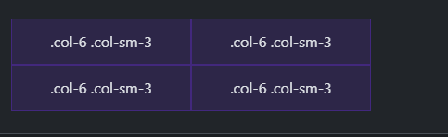
Bootstrap
Columns
<div class="container text-center">
<div class="row">
<div class="col-6 col-sm-3">.col-6 .col-sm-3</div>
<div class="col-6 col-sm-3">.col-6 .col-sm-3</div>
<!-- Force next columns to break to new line -->
<div class="w-100"></div>
<div class="col-6 col-sm-3">.col-6 .col-sm-3</div>
<div class="col-6 col-sm-3">.col-6 .col-sm-3</div>
</div>
</div>
Notes:
https://medium.com/why-i-chose-to-switch-career-paths-and-pursue/bootstrap-4-grid-system-10565a957020

Slide 20
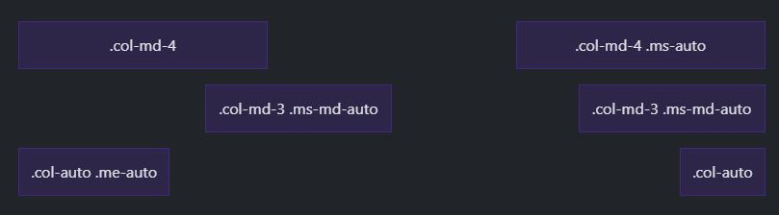
Bootstrap
Margin utilities
With the move to flexbox in v4, you can use margin utilities like .me-auto to force sibling columns away from one another.
Notes:
https://medium.com/why-i-chose-to-switch-career-paths-and-pursue/bootstrap-4-grid-system-10565a957020

Slide 21
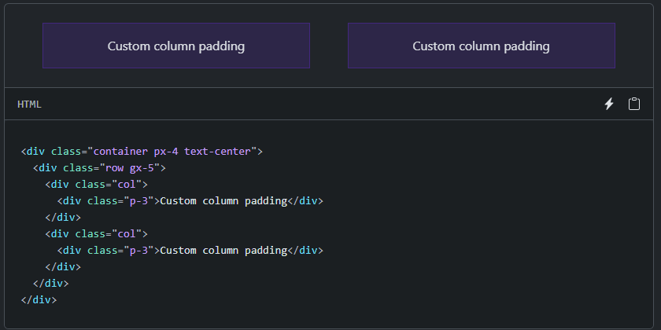
Bootstrap
Gutters
Gutters are the padding between your columns, used to responsively space and align content in the Bootstrap grid system.
Notes:
https://medium.com/why-i-chose-to-switch-career-paths-and-pursue/bootstrap-4-grid-system-10565a957020

Slide 22
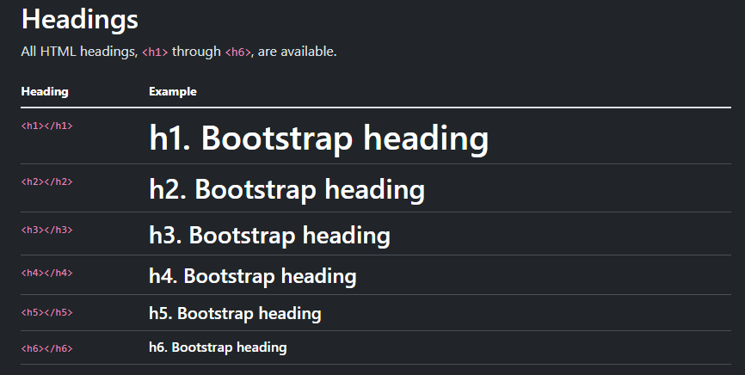
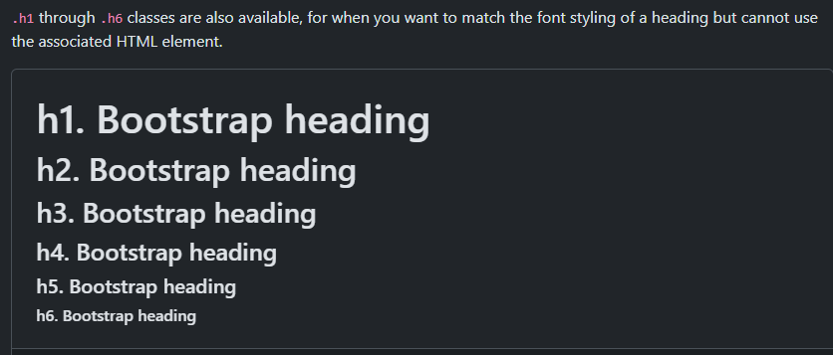
Bootstrap
Typography
Documentation and examples for Bootstrap typography, including global settings, headings, body text, lists, and more.
Notes:
https://getbootstrap.com/docs/5.3/content/typography/

Slide 23

Bootstrap
Images
Documentation and examples for opting images into responsive behavior (so they never become wider than their parent) and add lightweight styles to them—all via classes.
Responsive images
Images in Bootstrap are made responsive with .img-fluid. This applies max-width: 100%; and height: auto; to the image so that it scales with the parent width.
Notes:
https://getbootstrap.com/docs/5.3/content/typography/

Slide 24
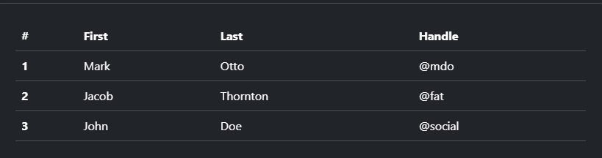
Bootstrap
Tables
Documentation and examples for opt-in styling of tables (given their prevalent use in JavaScript plugins) with Bootstrap.
Due to the widespread use of <table> elements across third-party widgets like calendars and date pickers, Bootstrap’s tables are opt-in. Add the base class .table to any <table>, then extend with our optional modifier classes or custom styles. All table styles are not inherited in Bootstrap, meaning any nested tables can be styled independent from the parent.
Using the most basic table markup, here’s how .table-based tables look in Bootstrap.
Notes:
https://getbootstrap.com/docs/5.3/content/tables/

Slide 25
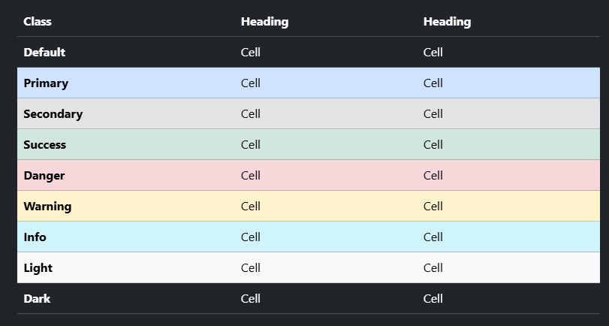
Bootstrap
Tables
Documentation and examples for opt-in styling of tables (given their prevalent use in JavaScript plugins) with Bootstrap.
Notes:
https://getbootstrap.com/docs/5.3/content/tables/

Slide 26
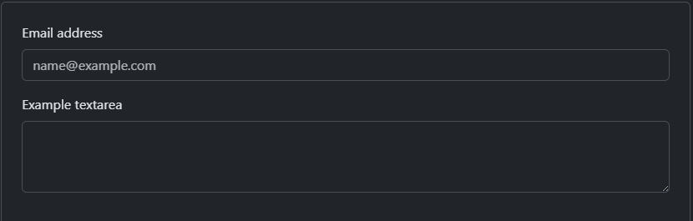
Bootstrap
Form controls
Give textual form controls like <input>s and <textarea>s an upgrade with custom styles, sizing, focus states, and more.
Notes:
https://getbootstrap.com/docs/5.3/forms/form-control/

Slide 27
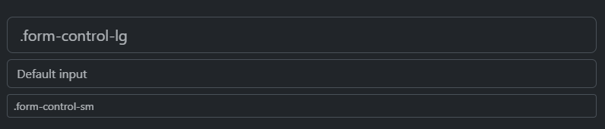
Bootstrap
Sizing
Set heights using classes like .form-control-lg and .form-control-sm.
Notes:
https://getbootstrap.com/docs/5.3/forms/form-control/

Slide 28
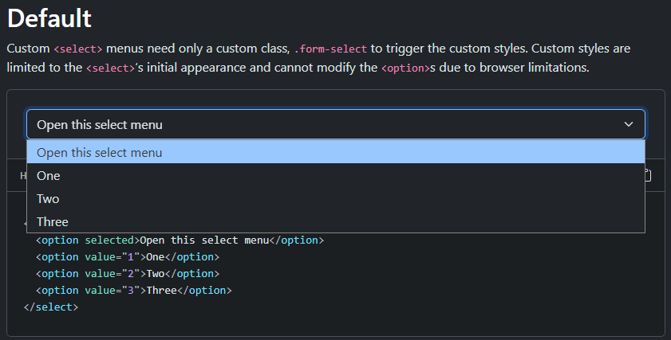
Bootstrap
Select
Customize the native <select>s with custom CSS that changes the element’s initial appearance.
Notes:
https://getbootstrap.com/docs/5.3/forms/select/

Slide 29
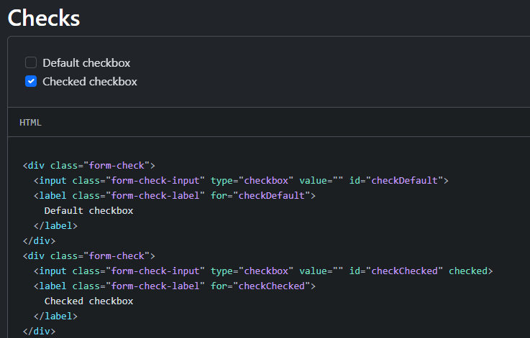
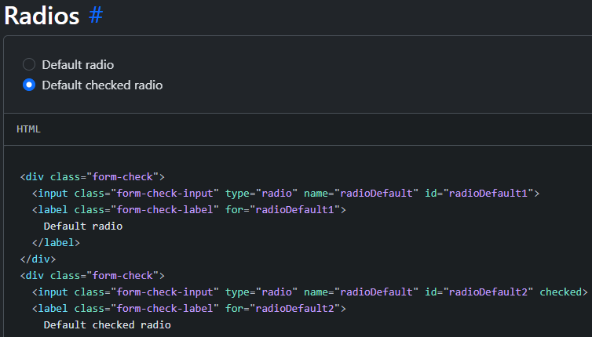
Bootstrap
Checks and radios
Create consistent cross-browser and cross-device checkboxes and radios with our completely rewritten checks component.
Notes:
https://getbootstrap.com/docs/5.3/forms/checks-radios/

Slide 30
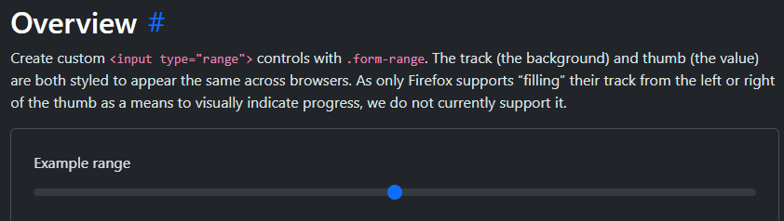
Bootstrap
Range
Use our custom range inputs for consistent cross-browser styling and built-in customization.
Notes:
https://getbootstrap.com/docs/5.3/forms/range/

Slide 31
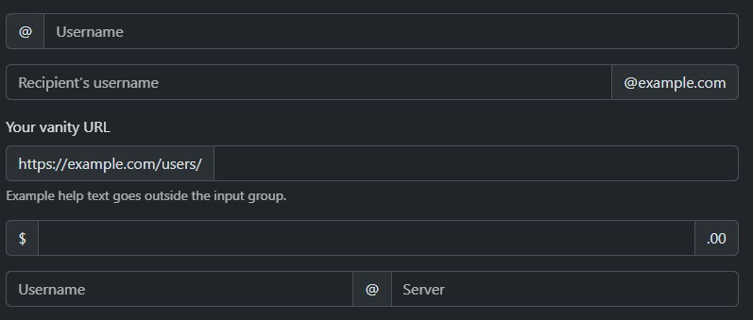
Bootstrap
Input group
Easily extend form controls by adding text, buttons, or button groups on either side of textual inputs, custom selects, and custom file inputs.
Notes:
https://getbootstrap.com/docs/5.3/forms/input-group/

Slide 32

Bootstrap
Navbar
  Use: Site navigation
Notes:
https://getbootstrap.com/docs/5.3/forms/input-group/

Slide 33
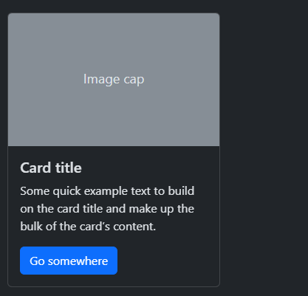
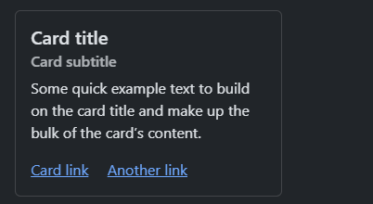
Bootstrap
Cards
Bootstrap’s cards provide a flexible and extensible content container with multiple variants and options.
Notes:
https://getbootstrap.com/docs/5.3/components/card/#about

Slide 34
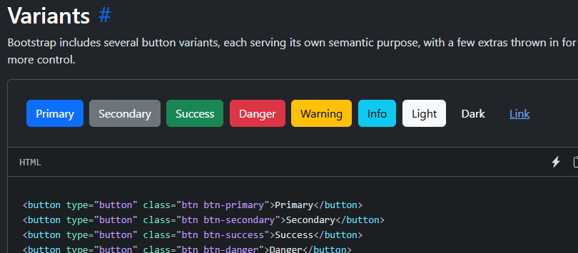
Bootstrap
Buttons
Use Bootstrap’s custom button styles for actions in forms, dialogs, and more with support for multiple sizes, states, and more.
Notes:
https://getbootstrap.com/docs/5.3/components/buttons/#base-class

Slide 35
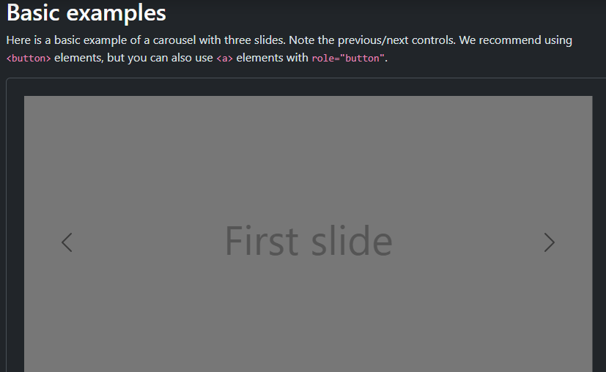
Bootstrap
Carousel
A slideshow component for cycling through elements—images or slides of text—like a carousel.
Notes:
https://getbootstrap.com/docs/5.3/components/carousel/

Slide 36
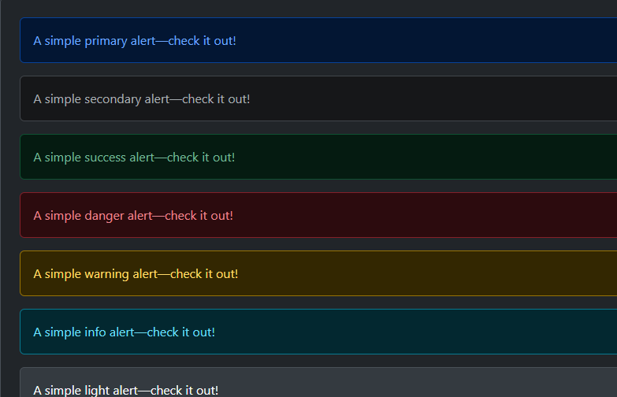
Bootstrap
Alerts
Provide contextual feedback messages for typical user actions with the handful of available and flexible alert messages.
Notes:
https://getbootstrap.com/docs/5.3/components/carousel/

Slide 37
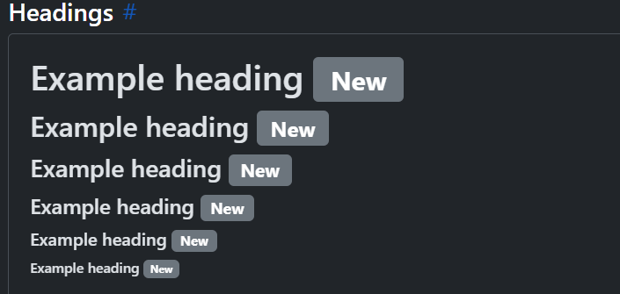
Bootstrap
Badges
Documentation and examples for badges, our small count and labeling component.
Notes:
https://getbootstrap.com/docs/5.3/components/carousel/

Slide 38
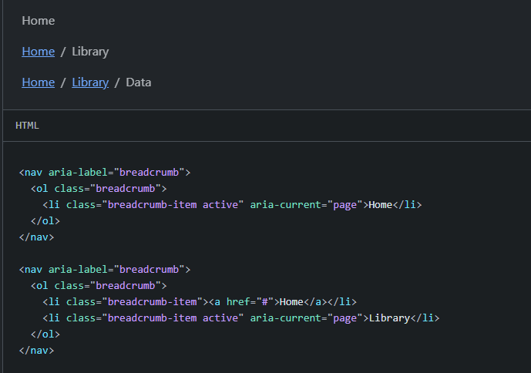
Bootstrap
Breadcrumb
Indicate the current page’s location within a navigational hierarchy that automatically adds separators via CSS.
Notes:
https://getbootstrap.com/docs/5.3/components/breadcrumb/

Slide 39
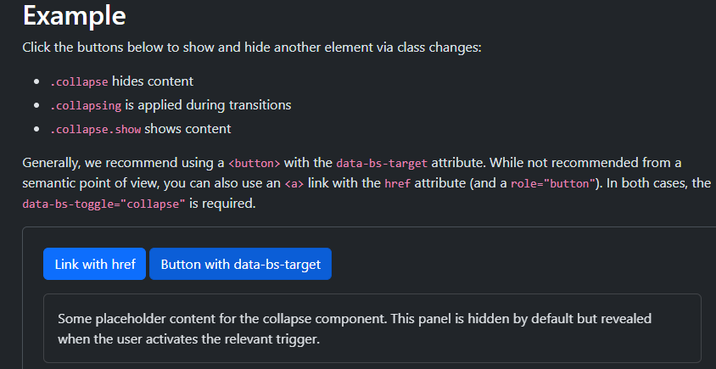
Bootstrap
Collapse
Toggle the visibility of content across your project with a few classes and our JavaScript plugins
Notes:
https://getbootstrap.com/docs/5.3/components/collapse/

Slide 40
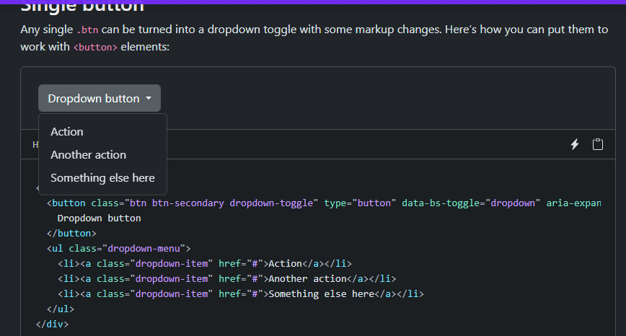
Bootstrap
Dropdowns
Toggle contextual overlays for displaying lists of links and more with the Bootstrap dropdown plugin.
Notes:
https://getbootstrap.com/docs/5.3/components/collapse/

Slide 41
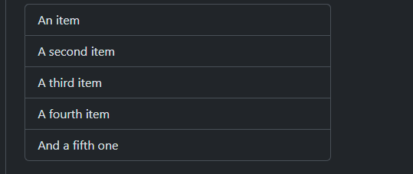
Bootstrap
List group
List groups are a flexible and powerful component for displaying a series of content. Modify and extend them to support just about any content within.
Notes:
https://getbootstrap.com/docs/5.3/components/list-group/

Slide 42
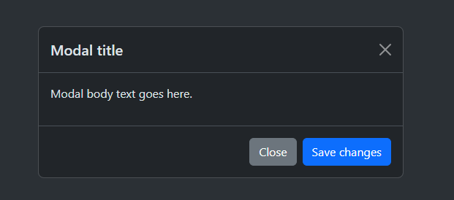
Bootstrap
Modal
Use Bootstrap’s JavaScript modal plugin to add dialogs to your site for lightboxes, user notifications, or completely custom content.
Notes:
https://getbootstrap.com/docs/5.3/components/modal/

Slide 43
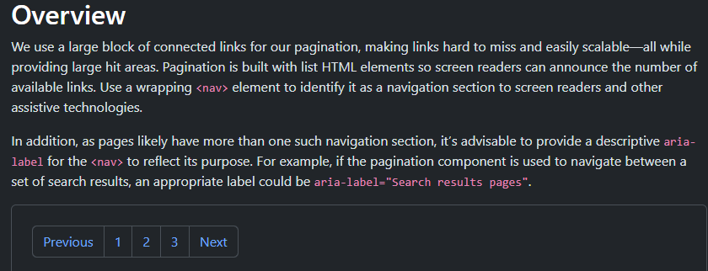
Bootstrap
Pagination
Documentation and examples for showing pagination to indicate a series of related content exists across multiple pages.
Notes:
https://getbootstrap.com/docs/5.3/components/pagination/

Slide 44
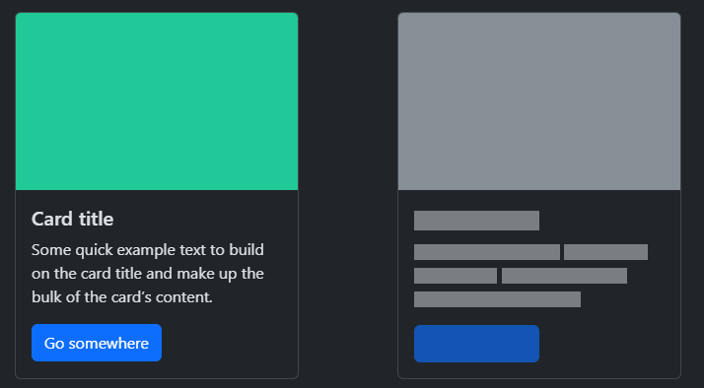
Bootstrap
Placeholders
Use loading placeholders (skeleton loaders) for your components or pages to indicate something may still be loading.
Notes:
https://getbootstrap.com/docs/5.3/components/placeholders/

Slide 45
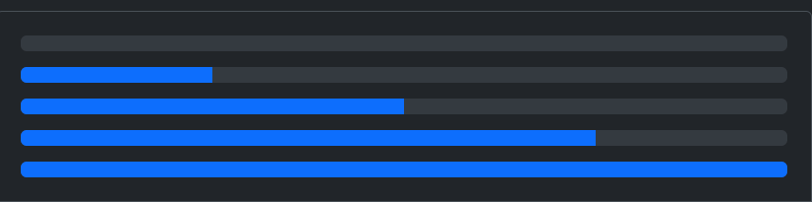
Bootstrap
Progress
Documentation and examples for using Bootstrap custom progress bars featuring support for stacked bars, animated backgrounds, and text labels.
Notes:
http://getbootstrap.com/docs/5.3/components/progress/

Slide 46
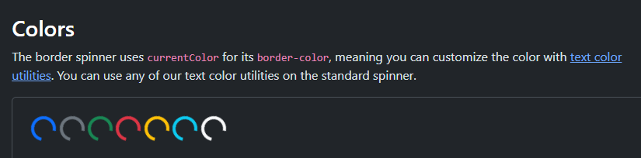
Bootstrap
Spinners
Indicate the loading state of a component or page with Bootstrap spinners, built entirely with HTML, CSS, and no JavaScript.
Notes:
https://getbootstrap.com/docs/5.3/components/spinners/

Slide 47
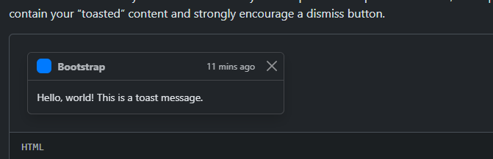
Bootstrap
Toasts
Push notifications to your visitors with a toast, a lightweight and easily customizable alert message.
Notes:
https://getbootstrap.com/docs/5.3/components/spinners/

Slide 48
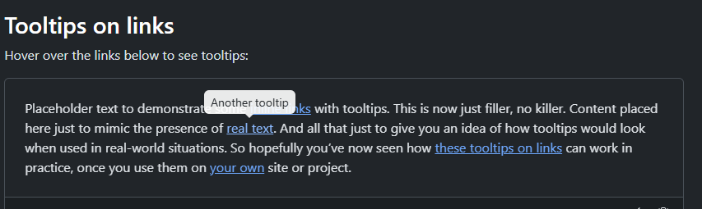
Bootstrap
Tooltips
Documentation and examples for adding custom Bootstrap tooltips with CSS and JavaScript using CSS3 for animations and data-bs-attributes for local title storage.
Notes:
https://getbootstrap.com/docs/5.3/components/tooltips/

